Slide 1
REGULAR MEETING OF THE
ARKANSAS HIGHER EDUCATION
COORDINATING BOARD
July 30, 2021

Slide 2
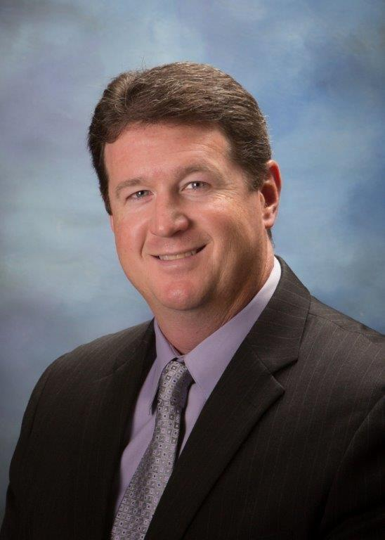
New AHECB Member
Allan Bohn

Slide 3
Roll Call
Al Brodell, Chair
Keven Anderson, Vice Chair
Lori Griffin, Secretary
Graycen Bigger
Allan Bohn
Dr. Jim Carr
Dr. Jerry Cash
Chad Hooten
Andy McNeill
Dr. Kyle Miller
Greg Revels
Dr. Michael Stanton

Slide 4

Agenda item no. 14: certification of budgeted intercollegiate athletic revenues and expenditures for 2021-2022
Nick Fuller
Assistant Director for Finance

Slide 5
Athletic Fees Per SSCH
Institution | 2020-21 Athletic Fee | 2021-22 Athletic Fee
ASUJ | $19.00 | $19.00
ATU | $20.00 | $20.60
HSU | $19.75 | $21.00
SAUM | $19.00 | $19.00
UAF | $0.00 | $0.00
UAFS | $18.00 | $18.00
UALR | $22.00 | $22.00
UAM | $18.00 | $18.00
UAPB | $22.00 | $22.00
UCA | $19.00 | $20.00
SAUT | $9.00 | $10.00

Slide 6
Intercollegiate Athletic
Budget Report for 2021-22

Slide 7
Intercollegiate Athletic
Budget Report for 2021-22

Slide 8
Intercollegiate Athletic
Budget Report for 2021-22

Slide 9
Intercollegiate Athletic
Budget Report for 2021-22

Slide 10
Any Questions?

Slide 11
Agenda item no. 14b:
Economic feasibility of a loan for the university of Arkansas, Fayetteville
Nick Fuller
Assistant Director for Finance

Slide 12
Relevant Information
$13,000,000 with a term of ten (10) years @ a rate not to exceed 4.0% from bank loan
Educational and general purposes (E&G) ($9.7M) and Auxiliary purposes ($3.3M)
Revenue Funding Source: Tuition & Fees and auxiliary revenue
Proceeds from the loan will be used to fund an energy savings performance project

Slide 13
Any Questions?

Slide 14


Dr. Jessie J Walker
Associate Director for Academic Affairs

Slide 15
ACADEMIC COMMITTEE
CONSENT AGENDA ITEMS

Slide 16
Consent Items
*15. Arkansas State University- Jonesboro
Master of Science in Nutrition and Dietetics
Traditional - Master of Science in Nutrition and Dietetics
*16. Southern Arkansas University- Tech
Technical Certificate-Cosmetology Instructor
*17. Southern Arkansas University- Tech
Associate of Applied Science in Diagnostic Medical Sonography
*Numbers refer to main agenda

Slide 17

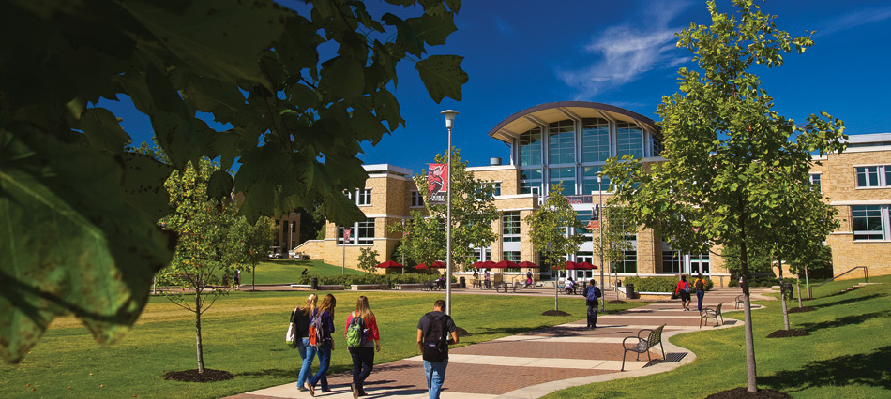

Master of Science in Nutrition and Dietetics (MSND) and transitional Master of Science in Nutrition and Dietetics (tMSND)
Karen Wheeler, Ph.D.
Senior Associate Vice Chancellor for Academic Affairs
AState.edu
/ArkansasState
@ArkansasState

Slide 18
Master of Science in Nutrition and Dietetics (MSND)
Beginning in 2024, individuals seeking the Registered Dietitian Nutritionist’s credential must possess a graduate degree from an accredited program to meet eligibility guidelines to sit for the licensure examination.
The proposed MSND will allow the Dietetics program to remain in compliance with the new Accreditation Council for Education in Nutrition and Dietetics and Commission on Dietetic Registration requirements, which mandate that existing programs offer a master’s degree by 2023.
The MSND will be an accredited nonthesis degree for individuals who are seeking the Registered Dietitian Nutritionists credential. The comprehensive curriculum will give students the necessary background to enter the field of nutrition and dietetics. It will be a hybrid master’s program delivered largely online
AState.edu
/ArkansasState
@ArkansasState

Slide 19
Transitional Master of Science in Nutrition and Dietetics (tMSND)
The tMSND will be an unaccredited 100% online nonthesis degree for Registered Dietitian Nutritionists (RDNs) or healthcare professionals who are seeking to continue their education by earning a graduate degree. This option will not be appropriate for individuals who are seeking the RDN credential as it will not lead to eligibility for the Registration Examination through the Commission on Dietetic Registration.
AState.edu
/ArkansasState
@ArkansasState

Slide 20
Cost
New costs to support the MSND program include one twelve-month faculty member ($65,000 plus benefits), one nine-month faculty member ($50,000 plus benefits), and one 11-month graduate assistant ($9,724). Adjunct faculty will be added as necessary. The program will also be supported by existing faculty within the College of Nursing and Health Professions and University.
Offering the tMSND in addition to the MSND will not add new costs, as faculty from the Master of Science in Nutrition and Dietetics will be utilized. Nine courses are shared between the two degrees.
Tuition will be the primary source of funding for the MSND. The projected annual student enrollment is 15, which is the approved number of students per accreditation.
AState.edu
/ArkansasState
@ArkansasState

Slide 21
Any Questions?

Slide 22
Consent Items
*15. Arkansas State University- Jonesboro
Master of Science in Nutrition and Dietetics
Traditional - Master of Science in Nutrition and Dietetics
*16. Southern Arkansas University- Tech
Technical Certificate-Cosmetology Instructor
*17. Southern Arkansas University- Tech
Associate of Applied Science in Diagnostic Medical Sonography
*Numbers refer to main agenda

Slide 23
Southern Arkansas University Tech
Associate of Applied Science
Medical Diagnostic Sonography
New Program Proposal

Slide 24
Need Analysis
The Workforce Analysis results show that the job market for this major is strong.
Based on the U.S. Bureau of Labor and Statistics website, the job outlook from 2018 to 2028 is an increase of 17%.
One employer surveyed in this area indicates that their hospital will likely have 1-2 positions available within the next 2-5 years and that the need for this occupation will grow as the population of aging individuals increases, stating “our communities deserve to have staff that are adequately trained to ensure that they are getting the care that they deserve”.

Slide 25
How does the proposed program meet regional/community/student needs?
There are no other Associate Degree Programs in Diagnostic Medical Sonography in the State of Arkansas.
Students in South Arkansas would benefit from a 2 year degree program versus a 4 year degree.
The healthcare facilities in South Arkansas would greatly benefit from trained and certified sonographers and would have an employee pool to choose from.
Since the announcement of this program, the College has received numerous calls from individuals interested in enrolling into the program.

Slide 26
SAU Tech’s Strategic Needs
Based on promising research statistics, SAU Tech would like to grow its allied health programs by providing additional career opportunities to prospective students.
Feedback received from local hospitals indicated a need for this program.
There are no other programs of this kind in this part of the state.

Slide 27
Budget Items
The building, classroom, and scanning laboratory are all in place.
Additional equipment will include ultrasound machines, simulation phantoms, program accreditation fees, and miscellaneous supplies.

Slide 28
Grant Funding
Workforce Opportunity for Rural Communities : $940,569 (Years 1 thru 3)
  Program Director/Instructor
  Equipment and Supplies
  Student Resource Coordinator
  (The Student Support funds were included in the grant to be awarded to needy students based on the Arkansas Career Pathways Model)
ACC Ready for Life Grant: $78,413.50 (Year One)

Slide 29
Expected Graduate Salaries
Students entering the field with an entry level education and certification through the American Registry for Diagnostic Medical Sonography (ARDMS) and/or American Registry for Radiologic Technologists (ARRT) can anticipate a median pay of $28.80 per hour based on 367 online job advertisements in Arkansas between January 2020- January 2021. (Source: Chmura Analytics)

Slide 30

Final Thoughts…
As you can see, Diagnostic Medical Sonography is a growing field with promising employment opportunities and salaries. Based on the facts obtained, South Arkansas and the surrounding areas can benefit from the implementation of this allied health program.

Slide 31
Any Questions?

Slide 32
Consent Items
*18. University of Arkansas-Monticello
Master of Science in Nursing(MSN) in Public Health
Post-Master’s Certificate in Public Health Nursing
*19. University of Arkansas-Pine Bluff
Master of Education (M.ED) Vocational Rehabilitation Addiction Counseling
Master of Business Administration (MBA)
*Numbers refer to main agenda

Slide 33

School of Nursing
Masters of Science in Nursing
Public Health Nursing focus
Post-Master’s Certificate

Slide 34
Need Analysis
Workforce Analysis
  Education attainment in matched occupations
  Tools to develop policy, address advocacy, and be a voice
Employer need survey results
  Over 500 Employer Needs Survey mailed in 2019.
  N=17 returned from hospitals, home health agencies, AR Department of Health, Community Clinics, Colleges, and Public School Districts
    337 jobs specifically designated for MSN degrees with 122 positions currently open and 76 anticipated vacancies in the next two –five years.
    The number of current employees that would benefit from enrolling in the degree/post-masters certificate was 70.
Letters of Support
  Received N=28 from RNs in clinical settings, nursing graduates and currently enrolled nursing students
(Source: Chmura Analytics)

Slide 35
How Program Meets Regional, Community, and Student Needs
School districts, clinics and hospitals need RNs with public health emphasis.
Nursing faculty shortage
Increase community health opportunities (grants) and patient education
Public health expertise to fill in gaps
Pragmatic viewpoint based on healthcare delivery experience rather than solely on theory
Improve population health at the community, state or national level
Leadership and management positions

Slide 36
Fit within UAM’s Strategic Needs
First graduate nursing degree and First post-masters nursing specialty certificate
Recruiting
Stakeholders
  Collaboration: improve the health and wellness of the public
  Professionalism: promote person integrity, leadership and stewards of resources
Partnerships
  Teamwork: serving the communities of AR and beyond to improve health outcomes
  Economic: promote innovative leadership opportunities that promote and sustain economic development
  Ethics: providing holistic care
Education
  Diversity: embrace differences in the public by cultivating inclusiveness and respect
  Evidence-based: cultivate practices and foster innovations that continuously improves patient outcomes

Slide 37
Additional Budget Items
Year One
  Adjunct teachers
  Additional clinical instructors (part-time)
Year Two
  Adjunct teachers
  Additional undergraduate clinical instructors (part-time)
  Accreditation fee
Year Three
  Adjunct teachers
  Additional undergraduate clinical instructors
  Assistant Professor for undergraduate nursing program
The School of Nursing has sufficient space to house faculty
none
Grant Funding to Support Program

Slide 38
Expected Salaries of Graduates
Employer Needs Survey
  $40,000-$130,000
Bureau of Labor Statistics
  $58,277 annual salary
  RN job growth by 7% through 2029, including public health focus/certification
Opens door for other nursing careers ($72,000 - $106,000)
  Health Administration
  Policy
  Education
  Epidemiology
  Infection Control
  Biostatistics
  Informatics
  Disaster Management

Slide 39
Any Questions?

Slide 40
Consent Items
*18. University of Arkansas-Monticello
Master of Science in Nursing(MSN) in Public Health
Post-Master’s Certificate in Public Health Nursing
*19. University of Arkansas-Pine Bluff
Master of Education (M.ED) Vocational Rehabilitation Addiction Counseling
Master of Business Administration (MBA)
*Numbers refer to main agenda

Slide 41




Master of Education in
Vocational Rehabilitation with emphasis in Addiction Counseling
The University of Arkansas-Pine Bluff

Slide 42

Workforce Analysis

Slide 43
Needs Analysis Continued
Rehabilitation counselors are employed in settings:
    the Department of Veterans Affairs,
    community and rehabilitation programs,
    hospitals, state/federal systems of vocational rehabilitation,
    social security administration,
    private business and industry,
    insurance companies,
    substance abuse programs,
    and training and evaluation centers.

Slide 44

Regional, Community and Students Needs
Regional: What will make this program unique from the other established programs, is that not only is it face to face, but it specifically designed to address the needs of minority, marginalized and low-resource students in Southeast Arkansas. This will address the need to diversify the vocational rehabilitation counseling workforce.
Community: This program will not only enrich academic understanding, expand vocational rehabilitation capacity and position candidates for counseling and managerial responsibility and extended community or civic impact.
Students: The program of study includes experiences to prepare candidates to assume counseling roles in rehabilitation counseling organizations and to hold related specialized positions in government and the private sector.

Slide 45

Compatibility with Institutional Needs
UAPB Mission is to promote and sustain excellent academic programs that integrate quality instruction, research and student learning experiences responsive to the needs of a racially, culturally, and economically diverse student population. Graduates with a M.Ed. in Vocational Rehabilitation degree program will be highly qualified candidates for counseling positions and administrative positions in the state department of career education, education centers, private organizations, plus many more.
Institutional Needs: UAPB is in a growth pattern as it relates to its Graduate program offering. Over the last two years, the number of graduate students have grown by 38%. Over the last four years, the number of graduate students have grown by 50% (from 86 to 172).

Slide 46
Additional Budget Needs
The current budget allocated to the School of Education Graduate Programs is sufficient to operate the recommended Master of Education in Vocational Rehabilitation with emphasis in Addiction Counseling.
Current School of Education and Addiction Studies faculty will support courses offered within the program.

Slide 47
Grant Funding Support
Not Applicable at this time.

Slide 48
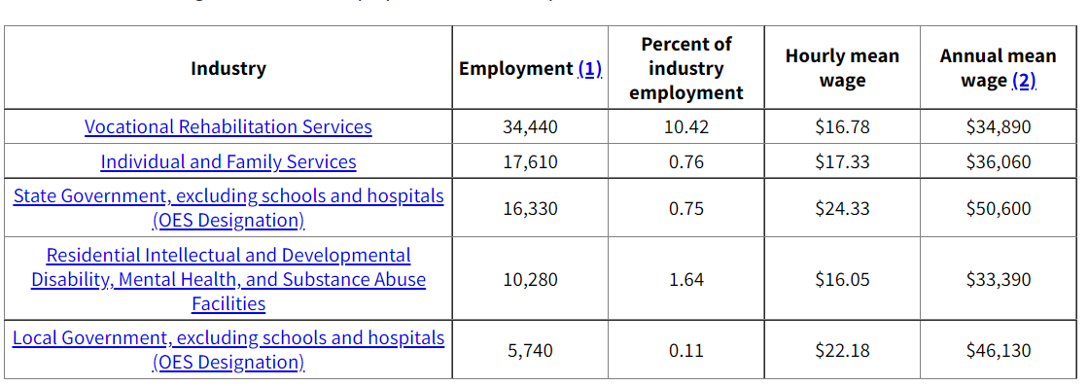

Expected Salaries of Graduates
The table below represents the salary scale obtained from employment in this occupation.

Slide 49
Master of Business Administration emphasis in
Gaming and Casino Management
Hospitality Management
Business Analytics
The University of Arkansas-Pine Bluff

Slide 50
Workforce Analysis
Quick Facts: Summary | Product Manager
2021 Median Pay | $66, 247/per year/$31.85 per hour
Typical Entry-Level Education | Master’s degree
Work Experience in a Related Occupation | None
On-the-job Training | None
Number of Jobs, 2020 | 150,736 +
Job Outlook, 2020 - 30 | 12% Job growth
Employment Change, 2020 - 30 | Program designed to help professionals create revolutionary, uplifting, and sustainable change in organizations throughout the economy.

Slide 51

Needs Analysis Continued
A Master of Business Administration (MBA) degree leads to many career opportunities for individuals who complete this rigorous program.
MBA completers are hired by:
corporations,
Government entities,
non-government entities,
and private businesses such as:
  retail,
  manufacturing,
  educational institutions,
  financial institutions,
  healthcare institutions,
  tourism industry,
  consulting firms,
  auditing firms,.
What will make this MBA program unique from the other established programs are the areas of specialization in gaming and casino management, hospitality management, and business analytics.

Slide 52
Regional, Community and Students Needs
Regional: What will make this program unique from the other established programs, is that not only is it face to face, but it specifically designed to address the needs of minority, marginalized and low-resource students in Southeast Arkansas. This will address the need to diversify the overall business workforce. This program will also assist the Saracen Casino Resort as it recruits highly qualified employees
Community: This program will not only enrich academic understanding, expand vocational rehabilitation capacity and position candidates for counseling and managerial responsibility and extended community or civic impact.
Students: We believe that the economic growth could be enhanced, albeit in a small way, by the realization of UAPB’s MBA program which will bring new faculty and students to the area. Additionally, it is hoped that enterprising MBA graduates will also recognize the growth potential in service industries such as restaurant and entertainment, as well as retail and accommodations that will follow as Pine Bluff’s economy begins to bounce back.

Slide 53
Compatibility with Institutional Needs
UAPB Mission is to promote and sustain excellent academic programs that integrate quality instruction, research and student learning experiences responsive to the needs of a racially, culturally, and economically diverse student population. Graduates with a M.B.A. in Gaming and Casino Management; Hospitality Management; and Business Analytics degree program will be highly qualified candidates for high level administrative positions in government, non-government and private organizations, plus many more.
Institutional Needs: UAPB is in a growth pattern as it relates to its graduate program offering. Over the last two years, the number of graduate students have grown by 38%. Over the last four years, the number of graduate students have grown by 50% (from 86 to 172). This will be the first graduate program in the School of Business and Management.

Slide 54
Additional Budget Needs
The current budget allocated to the School of Business and Management Programs is sufficient to operate the recommended Master of Business Management in Gaming and Casino Management, Hospitality Management, and Business Analytics.
Current School of Business and Management and Human Science faculty will support courses offered within the program.

Slide 55
Grant Funding Support
Not applicable at this time.

Slide 56
Expected Salaries of Graduates
The table below represents the salary scale obtained from employment in this occupation.
Occupation​ | Annual Wage ​
Arkansas Finance Lead/Controller​ | $80k-$88k​ ​
VP of Strategic Operations​ ​ | $110k-$168k ​
Data Management Officer​ ​ | $40k-$72k​
Plant Manager​ ​ | $63k-$129k ​
Procurement Manager​ ​ | $67k-$120k​

Slide 57
Any Questions?

Slide 58

AGENDA ITEM #20
INSTITUTIONAL CERTICATION ADVISORY COMMITTEE: RESOLUTIONS
Dr. Jessie J Walker
Associate Director for Academic Affairs

Slide 59
Institutional Certification Advisory Committee (ICAC)
3 Universities
19 Degree and Certificate Programs

Slide 60
Any Questions?

Slide 61
AGENDA ITEM #21
LETTERS OF NOTIFICATION
Dr. Jessie J Walker
Associate Director for Academic Affairs

Slide 62
Letters of Notification
Programs approved by the ADHE Director
Programs must be included on the AHECB agenda prior to initiation
Programs are reasonable and moderate extensions of existing certificates and degrees

Slide 63
AGENDA ITEM #22
LETTERS OF INTENT
Dr. Jessie J Walker
Associate Director for Academic Affairs

Slide 64
Letters of Intent
Notification of institutional plans to offer new programs or organizational units that require Coordinating Board approval
Chief academic officers and chief executive officers can comment on the proposals before consideration by AHECB

Slide 65
AHECB Full Board Meeting
July 30, 2021

Slide 66
Approval of Minutes
April 23 Regular Meeting

Slide 67
DR. MARIA MARKHAM
Agenda item no. 2:
REPORT OF THE DIRECTOR

Slide 68

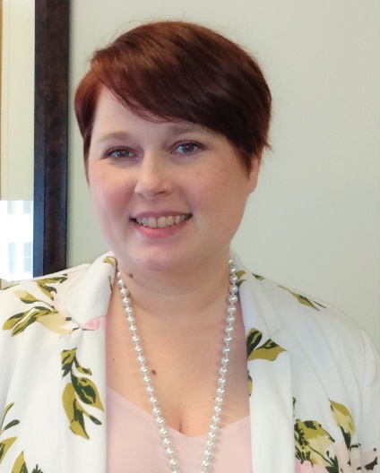
ADHE Staffing
JaCarlos Sheppard
AmeriCorps Program Officer
Started 7/19/2021
Beth Stewart
Senior Policy Analyst
Last day 7/30/2021

Slide 69
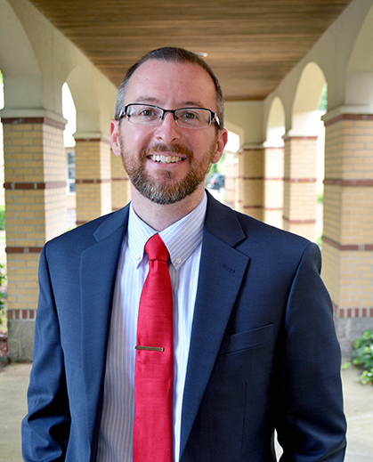
Institutional Leadership
Zachary Perrine has been named interim chancellor at the University of Arkansas Community College at Batesville (UACCB) following the May 31 retirement of longtime chancellor Deborah Frazier. Perrine joined the University of Arkansas Community College at Batesville as vice chancellor for student affairs in June 2020.

Slide 70
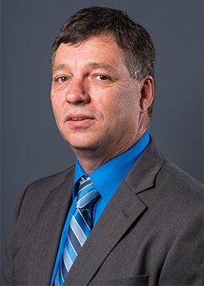
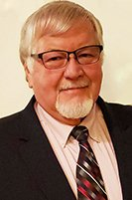
Institutional Leadership
Former president of North Arkansas College (Northark), Dr. Randy Esters accepted a position as the chancellor of Louisiana Delta Community College in Monroe, LA. beginning in June. Don Sugg was named interim president during the presidential search.
Dr. Rick Massengale, Northark’s VP for Academic and Student Affairs has been selected as the College’s fifth president. Massengale previously served at Arkansas Tech University in Russellville as associate vice president for sponsored programs and university initiatives and as a professor of computer and information science. He attended the University of the Ozarks in Clarksville, earning his Bachelor of Science degree in computer science from Arkansas Tech, Fort Smith. He earned his Doctor of Philosophy in applied science from the University of Arkansas, Little Rock.

Slide 71
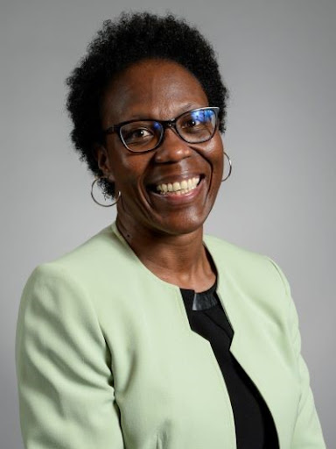
Institutional Leadership
University of Arkansas System President Dr. Donald R. Bobbitt recommended Christine Holt, D.B.A., J.D., as the next chancellor at the University of Arkansas Hope-Texarkana (UAHT).
Holt, who currently serves as chief of staff for the University of Missouri System, is expected to begin her new role by Sept. 1.

Slide 72

HIGHER EDUCATION
COVID-19 RESPONSE

Slide 73
Any Questions?

Slide 74

AGENDA ITEM #03
annual report-Concurrent education
Dr. Jessie J Walker
Associate Director for Academic Affairs

Slide 75

Annual Report on Concurrent Education
Concurrent Credit Courses
Concurrent credit courses must be freshman and/or sophomore-level courses approved through an established institutional process and included in the institutional course catalog.
The general education courses offered for concurrent credit must be listed in the Arkansas Course Transfer System (ACTS). A list of the career and technical education (CTE) courses offered for concurrent credit must be attached to the signed Memorandum of Understanding (MOU) between the high school/school district and the college/university.

Slide 76


Annual Report on Concurrent Education
Concurrent Course Ownership
Postsecondary institutions must demonstrate “ownership” of any course offered for concurrent credit for which students are reported for funding purposes. Ownership of courses means that the college/university will:
  Provide the instructors with appropriate training and orientation in course curriculum, assessment criteria
  Ensure that instructors receive continuing collegial interaction with college faculty through professional development, required seminars, and site visits
  Ensure that students have the opportunity to utilize institutional resources including the college/university library and academic advising on the college/university campus.

Slide 77
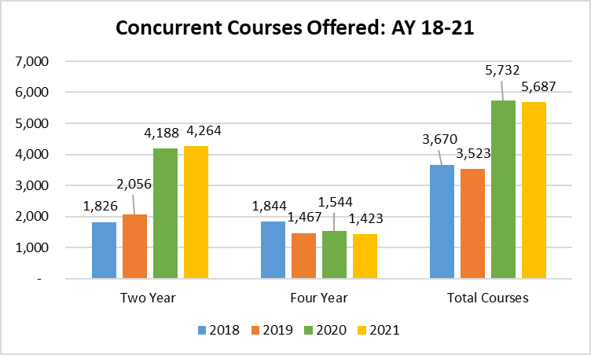
State of Concurrent Education in Arkansas
Statewide Overview
AY 18 to AY 21, the total number of concurrent courses offered by all public institutions decreased. By institutional type, concurrent course offerings decreased at four-year institutions by 8% but increased at two-year institutions by 2%. Further breakdown of institutional trends are noted below.

Slide 78
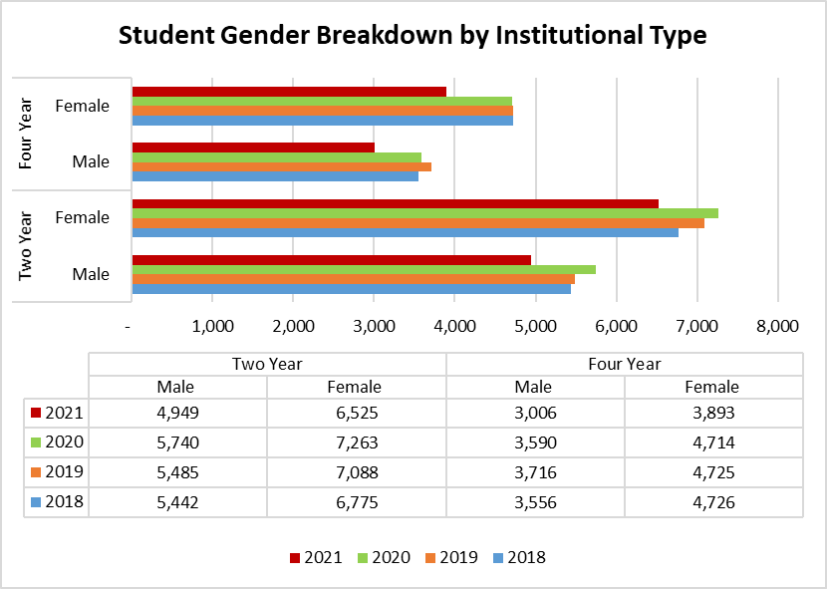
State of Concurrent Education in Arkansas
Concurrent Student Breakdown
Focusing solely on the concurrent student population, it is notable to acknowledge that more female students have enrolled in concurrent courses than male students for AY 18 and AY 21 regardless of the institutional type.

Slide 79
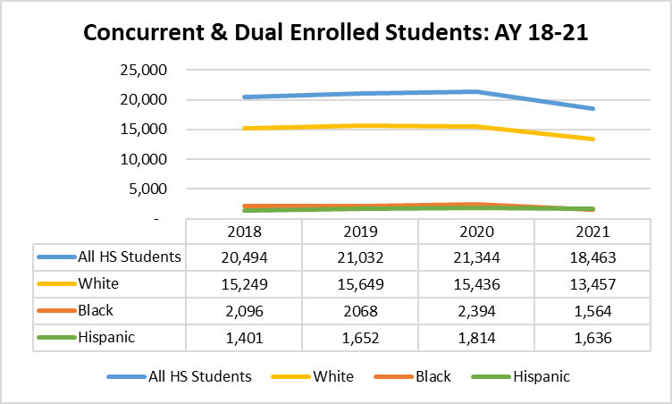
State of Concurrent Education in Arkansas
Concurrent Student Breakdown
The majority of students who have taken concurrent or dual enrollment at Arkansas public institutions in AY 21 have been White students (73%) followed by Hispanic (9%) and African-American students (8%). *
*Due to updates in our student information system, concurrent student data related to race or ethnicity in AY 20 will not be included in this report.

Slide 80
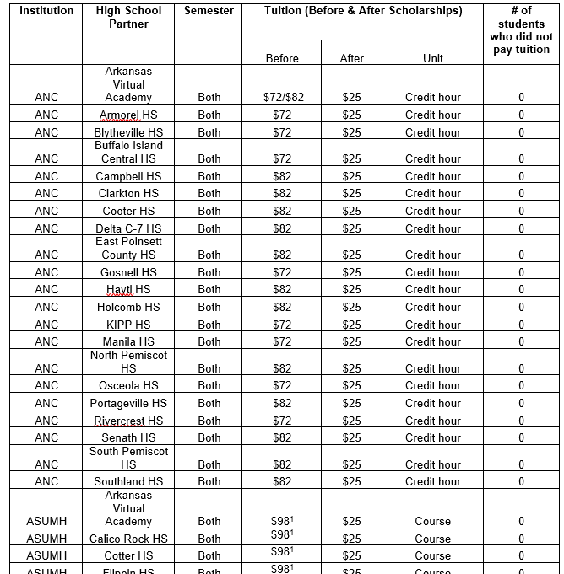
State of Concurrent Education in Arkansas
2020-2021 Listing of Concurrent Tuition Amounts Charged to Students from AHECB Approved Providers

Slide 81

State of Concurrent Education in Arkansas
Concurrent Authorization
During summer 2021, ADHE/AA staff worked with private institutions, that were interested in AHECB concurrent authorization Each institution’s concurrent program was assessed in the following areas by an independent panel:
  Concurrent Memorandums of Understanding (MOUs)
  Concurrent Course Offerings
  Concurrent Course Quality
    Student Learning Outcomes
    Syllabi
    Grading Standards
  Concurrent Instructors
  Grade Awarding & Recording
  Student Success, Persistence, & Retention Data

Slide 82

State of Concurrent Education in Arkansas
Updates Approved Concurrent Providers
Institution Name | Approval Date | Next Review Date
Harding University | 2021 | 2025-2026
Quachita Baptist University | 2021 | 2025-2026
Crowley’s Ridge College | 2021 | 2025-2026

Slide 83
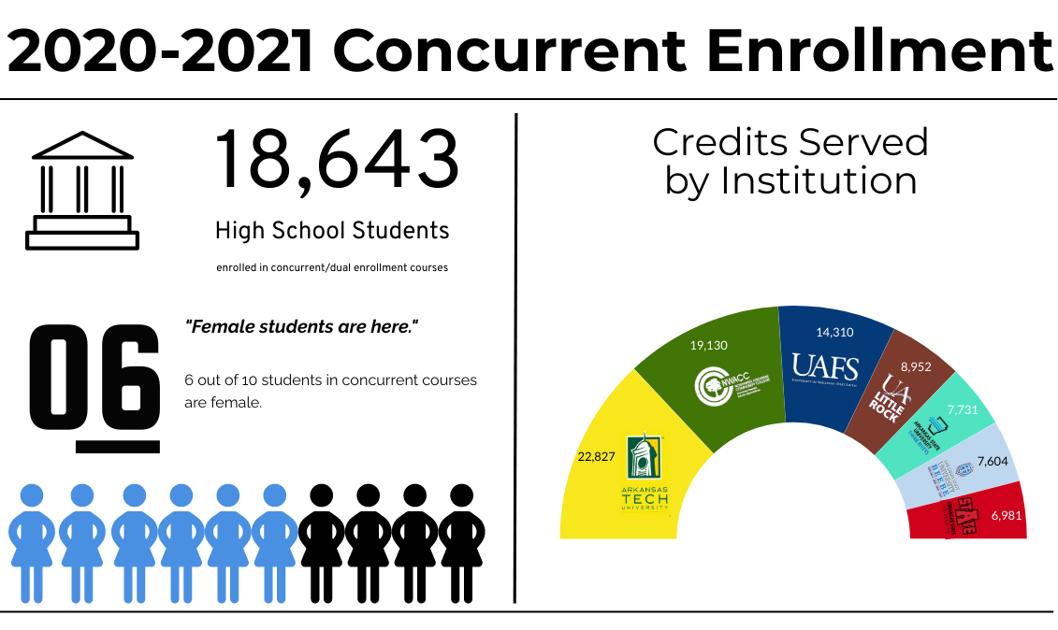
State of Concurrent Education in Arkansas

Slide 84
Any Questions?

Slide 85

AGENDA ITEM #4
Report of annual review of faculty performance
Dr. Jessie J Walker
Associate Director for Academic Affairs

Slide 86

Annual Review of Faculty Performance
Colleges and universities are required to conduct faculty performance reviews under Arkansas Code Annotated §6-63-104 and AHECB policy 5.5.
ADHE staff is required to monitor faculty evaluation processes adopted at Arkansas public institutions and report annually to the AHECB and Legislative Council.
All institutions conducted faculty performance reviews during 2020-2021 using a variety of methods including assessment by students, classroom visits by administrators, peer review, and self-evaluation activities.
Student Ratings
External Perspective
Artifacts

Slide 87
Annual Review of Faculty Performance Notable Findings
Institutions have implemented a variety of training programs to strength faculty development around performance review elements:
  Advising Techniques (e.g. intrusive advising, coaching, and mentoring)
  Tools/approaches to assess student learning outcomes in all online environments
Development of quantitative/qualitative component ratings of faculty
  Utilization of technology –remote teaching
  Transition support for online students
  Participation in English training including: English as a Second Language courses, and accent reduction training.

Slide 88
Any Questions?

Slide 89
FINANCE COMMITTEE REPORT

Slide 90
ACADEMIC COMMITTEE REPORT

Slide 91
PUBLIC COMMENTS/
ANNOUNCEMENTS
Follow-up questions can be sent to: Nichole.Abernathy@adhe.edu
Presentations will be posted on the ADHE website at:
https://www.adhe.edu/about-adhe/coordinating-board/board-presentations

